Slide 1


Data@ANZ Virtual Internship Program
Ravindi Nanayakkara
PhD Candidate/Researcher
La Trobe University, Australia
D.Nanayakkara@latrobe.edu.au

Slide 2
Task 1: Exploratory Data Analysis

Slide 3
Important attributes of Data@ANZ data set
Total number of transactions: 12043
Total number of customers: 100
Time duration: 3 months
Attributes
Status: Posted/ Authorized
Card present flag: 0/1 and missing data present
Account No: A unique I.D.
Transaction description: Internet Bank, Pay/Salary, Payment, Phone Bank, POS, Sales-POS
Merchant I.D.: A unique I.D. and missing data present
Balance
Date
Gender
Age
Merchant suburb: Categorical and missing data present
Merchant state: Categorical and missing data present
Debit/Credit amount
Transaction I.D.
Customer I.D.
Transaction type: Categorical and Credit, Debit
long_lat: Customer location and 1 missing value

Slide 4
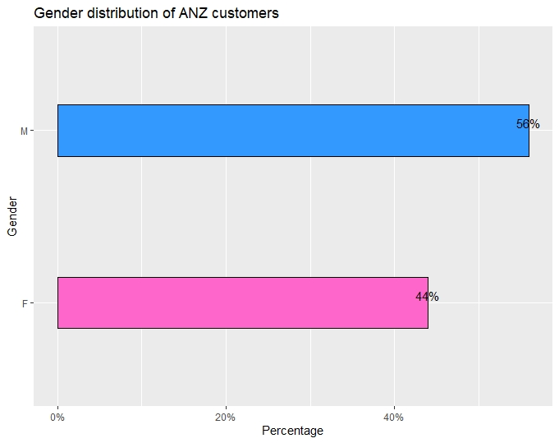
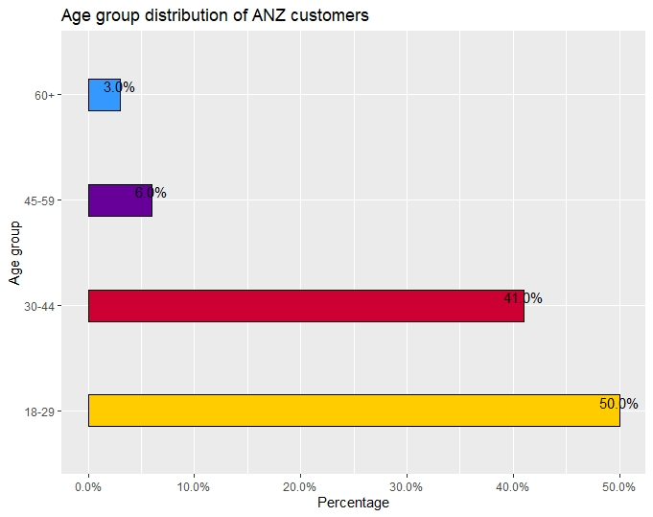
Demographic Analysis of ANZ Customers
Figure 1
Figure 2
First the demographic features of the 100 hypothetical customers in the ANZ customer base were analysed. It can be noticed from Figure 1 that the percentage of male customers is higher than that of female customers. Their percentages are 56% and 44% respectively. Next, it can be depicted from Figure 2 that majority of the customers are in ‘18-29’ and ‘30-44’ age groups which account for 91% of the customers. Youth represent the highest percentage with 50% while the senior citizens(‘60+’) represent the lowest percentage with only 3%. Middle aged and old people account for 41% and 6% respectively.

Slide 5
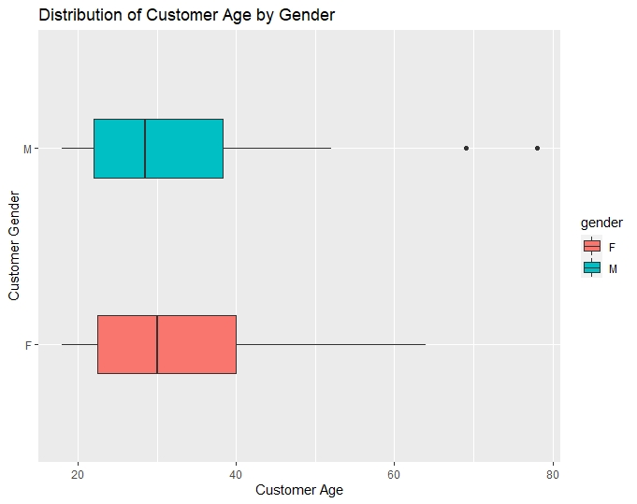
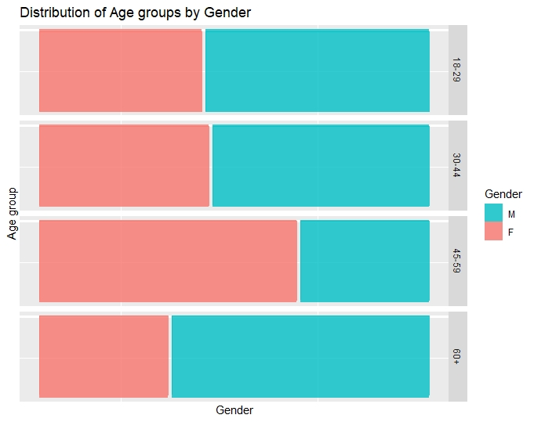
Demographic Analysis of ANZ Customers
Figure 3
Figure 4
It can be noticed from Figure 3 that both the age distributions of male and female customers are positively skewed suggesting that majority of them belong to youth and middle aged age categories. Two distinct outliers can be seen in the age distribution of male customers and the median age of females is higher than that of males. From the mosaic plot shown by Figure 4, the gender distribution in each age category can be summarised. In the age groups, ‘18-29’, ‘30-44’ and ‘60+’ the male representation is higher than that of females while the vice versa can be noticed in the age group ‘45-59’.

Slide 6
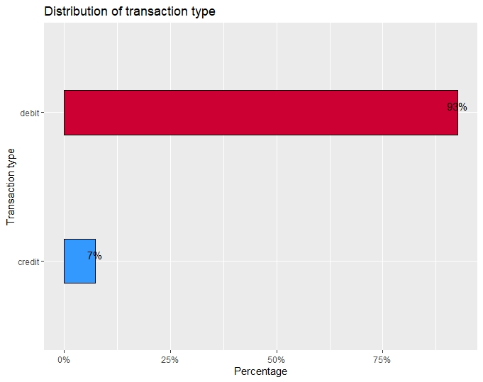
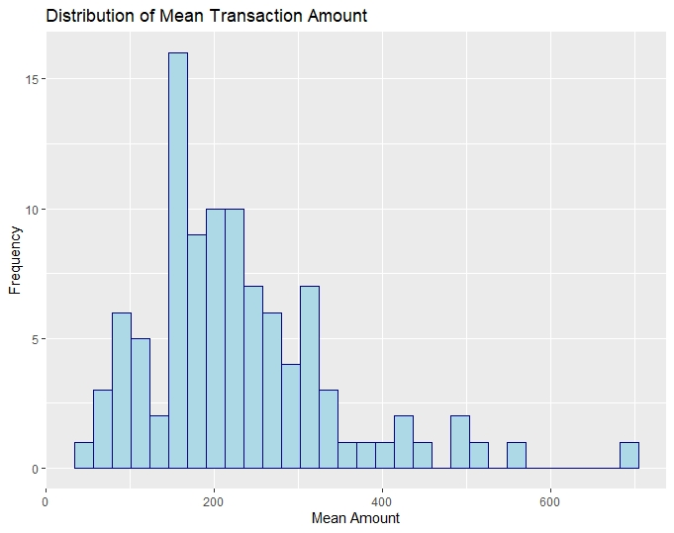
Transaction Analysis of ANZ Customers
Figure 5
Figure 6
It is clear from Figure 5 that the majority of the transactions are ‘Debit’ transactions which account for 93% of the transactions while minority of them are ‘Credit’ transactions(=7%). Figure 6 shows the distribution of mean transaction amount of ANZ customers and it is clear that the distribution is positively skewed with some outliers. Therefore, majority of the customers are likely to spend a mean amount around 200. As there were 12043 transactions recorded in the data set, the average transaction amount was found to be 187.93.

Slide 7
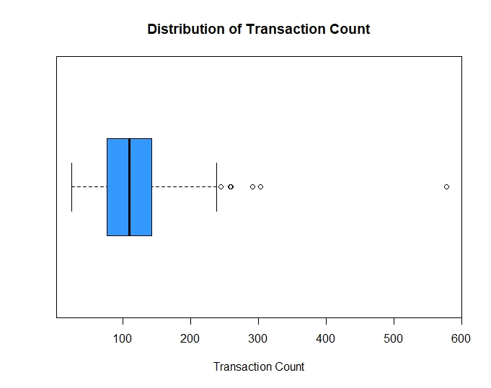
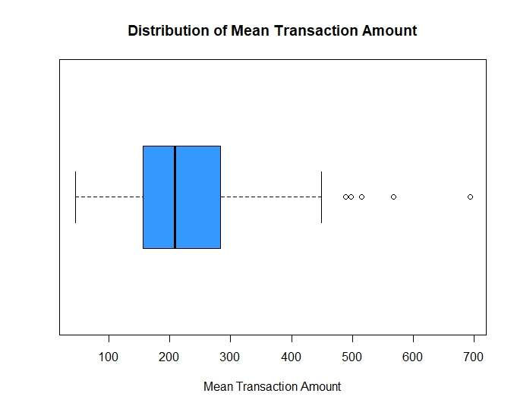
Transaction Analysis of ANZ Customers
Figure 7
Figure 8
Figure 7 shows the distribution of transaction counts made by each customer and it can be noticed that the distribution is positively skewed with noticeable outliers and extreme values. This suggests that majority of the customers make nearly 120 transactions while there are some customers who make even a maximum of 578 transactions. It can be seen from Figure 8 that the distribution of mean transaction amount is also positively skewed with distinct outliers and extreme values. Therefore majority of the customers engage in a mean transaction amount of nearly 228.

Slide 8
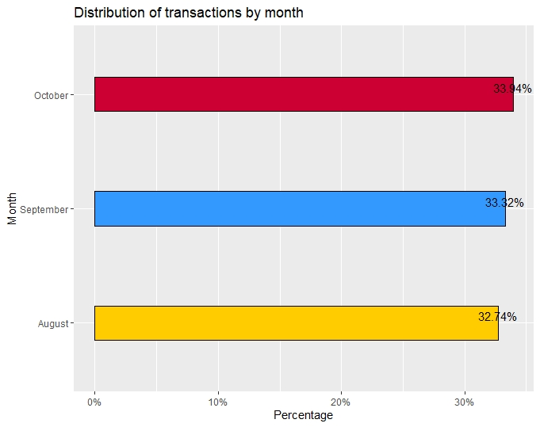
Transaction Analysis of ANZ Customers
Average transaction amount of the ANZ Customer Base = 187.93
Average transaction amount in August = 185.12
Average transaction amount in September = 182.05
Average transaction amount in October = 196.43
Average number of transactions made by a customer = 120.43 ~ 120 transactions
Average number of transactions made by customers in each month = 12043/3 = 4014.33
Figure 9
It can be depicted from Figure 9 that the percentage distribution of the number of transactions by month is almost the same and the transaction percentages of August, September and October are 32.74%, 33.32% and 33.94% respectively. The highest average transaction amount was found in October and it is even higher than the average transaction amount of the ANZ customer base. On average, customers make approximately 4014 transactions per month.

Slide 9
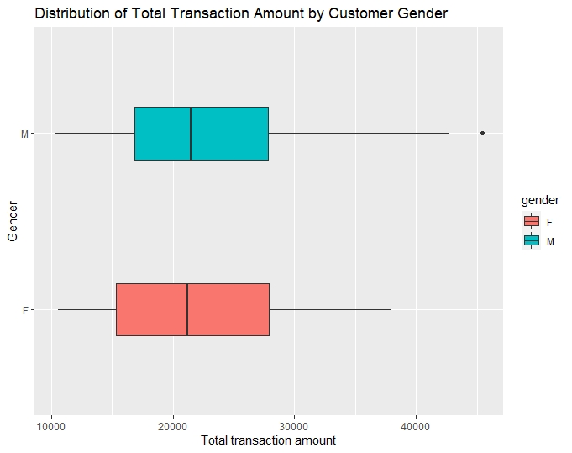
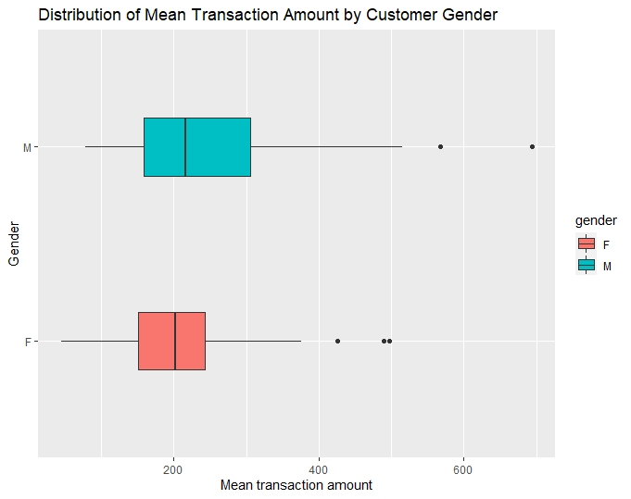
Transaction Analysis of ANZ Customers
Figure 10
Figure 11
Figure 10 displays the distribution of total transaction amount by customer gender. It is clear that the total transaction amount distributions of both males and females are positively skewed while an extreme value can be identified in the distribution of females. The median total transaction amount of both males and females is approximately equal. Figure 11 shows the distributions of mean transaction amount by customer gender. It can be seen that both the distributions are positively skewed with noticeable extreme values and have approximately the same median value. The spread of mean transaction amounts in males is higher than that of females suggesting that men vary more in mean transaction amounts.

Slide 10
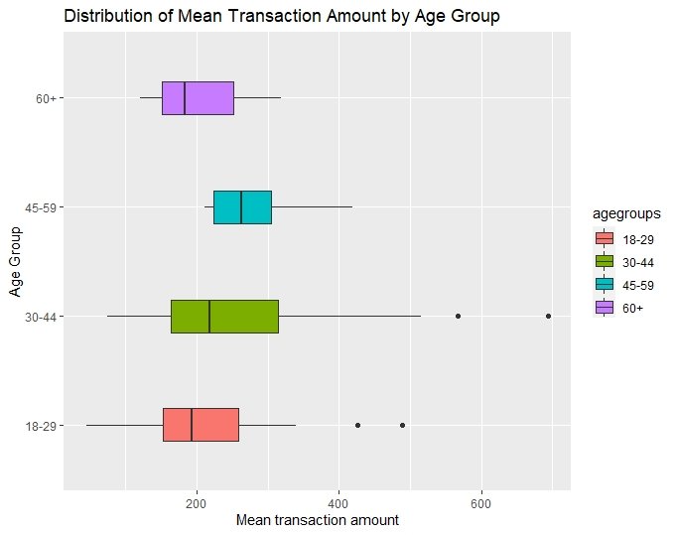
Transaction Analysis of ANZ Customers
Figure 12 shows the distribution of mean transaction amount by the customer age groups. It is clear that the distributions of mean transaction amount of all the age groups are positively skewed. The mean transaction amount distributions of ‘18-29’ and ‘30-44’ age groups have obvious extreme values. The age group ‘45-59’ has the highest median mean transaction amount while that of the age group ‘18-29’ is the lowest. That is, on average customers who are aged ‘45-59’ tend to engage in a high mean transaction amount than the youth(‘18-29’) and middle aged(‘30-44’) age groups. It was interesting to get revealed that customers aged ‘45-59’ engage in higher transaction amounts than the others on average. May be because they rely much on their savings and therefore withdraw money for their daily purposes. The spread of the mean transaction amount of ‘30-44’ age group is the highest suggesting that they are more varying in their mean transaction amounts and that of customers aged between ‘45-59’ is the lowest suggesting that they are more consistent in their mean transaction amounts.
Figure 12

Slide 11
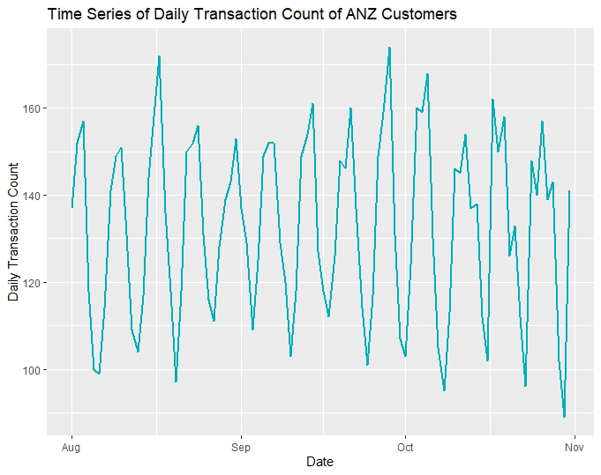
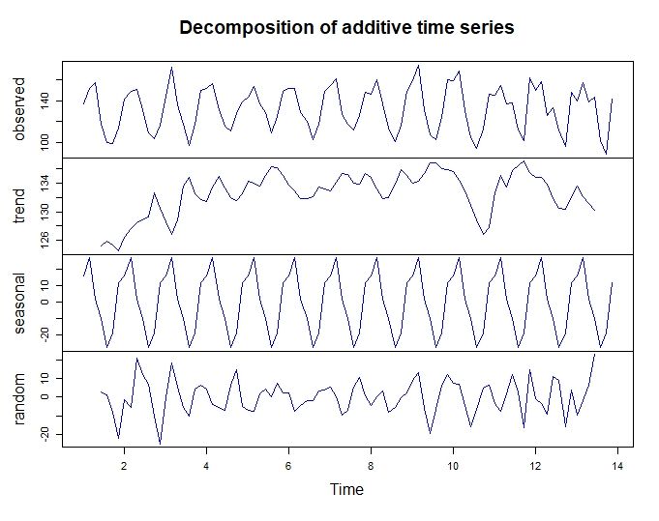
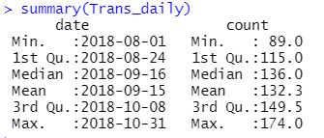
Daily Time Series Analysis of Transaction Count
Figure 13
Figure 14
It is clear from Figure 13 that the time series of daily transaction count show seasonality within each week. When the time series is decomposed into systematic and non-systematic components, there is no apparent trend in the time series. The mean and median transaction counts are 132 and 136, respectively. Since the seasonal variation looks constant, it does not change when the time series value increases. Therefore, the additive model can be suggested in this scenario for forecasting purposes.
Additive model : Time series = Seasonal + Trend + Random

Slide 12
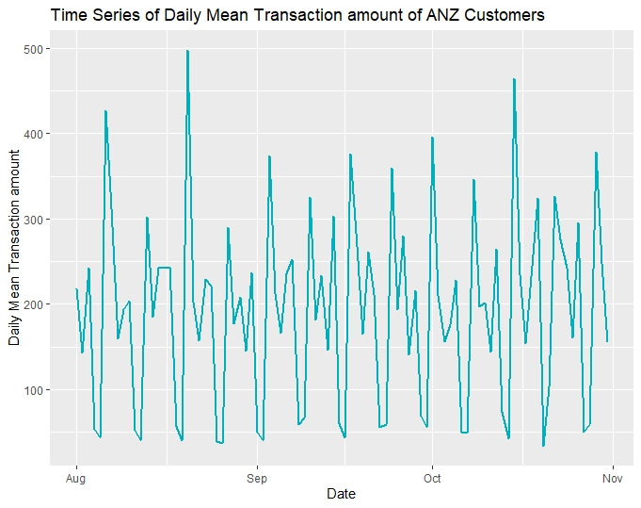
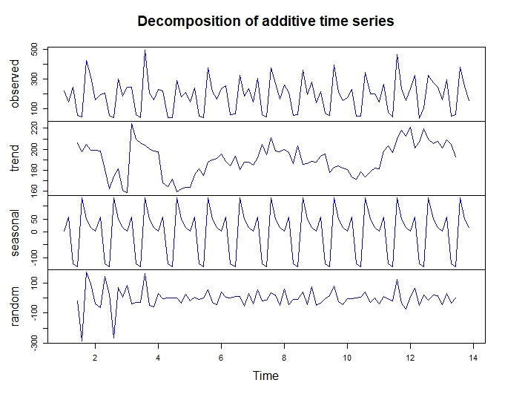
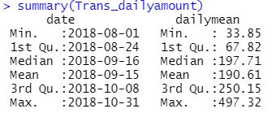
Daily Time Series Analysis of Mean Transaction Amount
Figure 15
Figure 16
It is clear from Figure 15 that the time series of daily mean transaction amount show seasonality within each week. When the time series is decomposed into systematic and non-systematic components, there is no apparent trend in the time series. The mean and median mean transaction amounts are 190 and 197, respectively. Since the seasonal variation looks constant, the additive model can be suggested in this scenario for forecasting purposes.
Additive model : Time series = Seasonal + Trend + Random

Slide 13
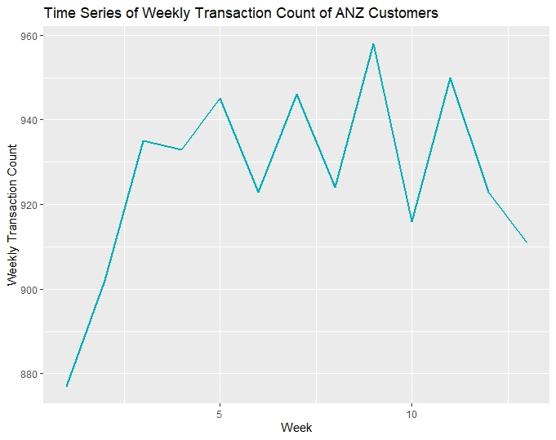
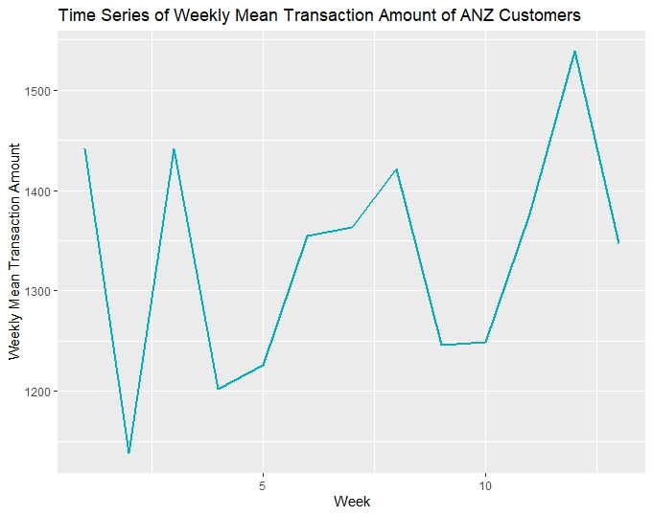
Weekly Time Series Analysis of Transaction Count and Mean Transaction Amount
Figure 17
Figure 18
It can be noticed from Figures 17 and 18 that the weekly time series of transaction count and mean transaction amount do not have any trend, seasonality or cyclic behaviour.

Slide 14
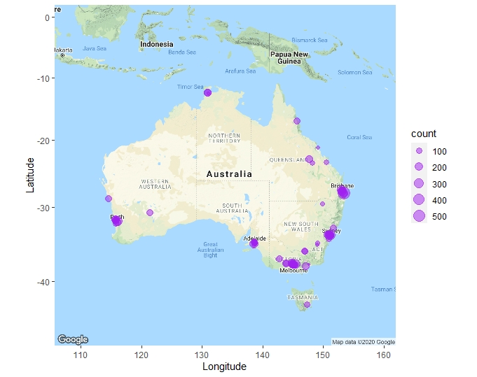
Geospatial Analysis of ANZ Customers

Slide 15
Geospatial Analysis of ANZ Customers by Transaction Count
It can be noticed from Figure 19 that most of the customers are residing in Victoria, New South Wales and Queensland states while a minority of the customers reside in the other states. Therefore more marketing campaigns should be hold in Western Australia, South Australia, Northern Territory and Tasmania in order to attract customers. Transaction volume seem to be higher in the major cities of Melbourne, Sydney, Brisbane, Adelaide and Perth. Therefore the ANZ bank should implement some strategies to attract customers from regional areas of each state.
When plotting the spatial locations of customers, one pair of coordinates was removed as it was found to be a missing value from the ‘R’ analysis.
Figure 19

Slide 16
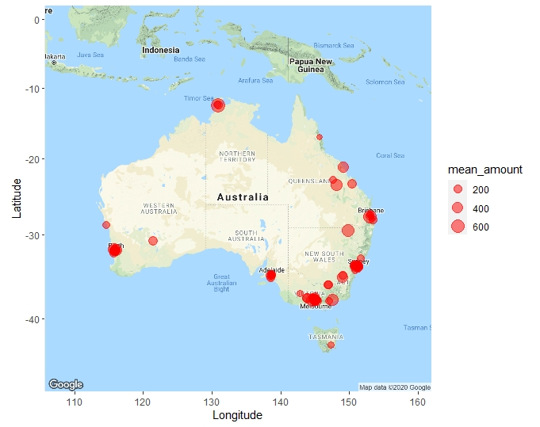
Geospatial Analysis of ANZ Customers by Mean Transaction Count
It can be noticed from Figure 20 that majority of the customers residing in Victoria, New South Wales and Queensland engage in higher mean transaction amounts. Therefore more marketing campaigns should be hold in Western Australia, South Australia, Northern Territory and Tasmania in order to attract customers and to introduce some interest plans to increase their interests. High mean transaction amounts are visible in the major cities of Melbourne, Sydney, Brisbane, Adelaide and Perth. Therefore the ANZ bank should implement some strategies to attract customers from regional areas of each state and to increase their transaction amounts.
Figure 20

Slide 17
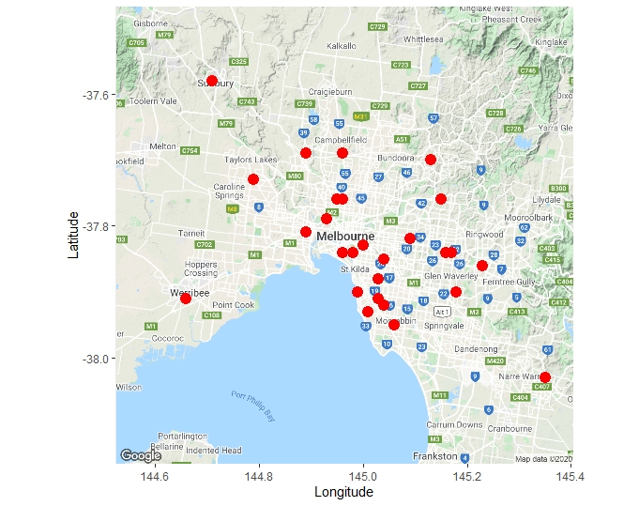
Geospatial Analysis of ANZ Customers residing in Melbourne
It can be depicted from Figure 21, that most of the transactions are made by customers residing within Melbourne area and very few customer transactions are visible in the regional. When going away from the Melbourne CBD, the number of transactions also decreases. Therefore, the ANZ management should implement some strategy to attract people living in regional areas of Victoria.
Figure 21

Slide 18
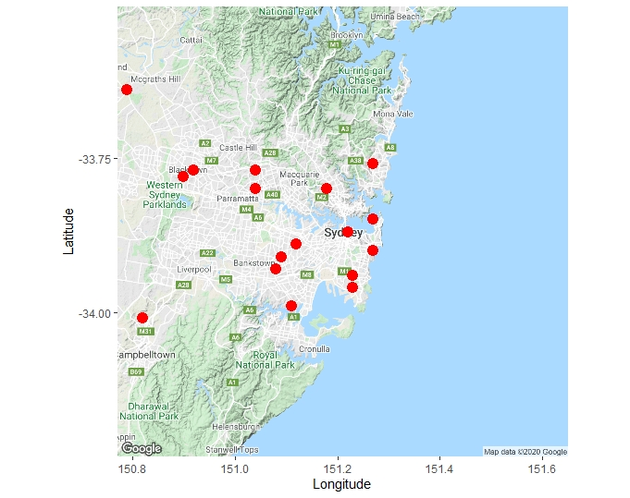
Geospatial Analysis of ANZ Customers residing in Sydney
It can be highlighted from Figure 22, that most of the transactions are made by customers residing within Sydney area and very few customer transactions are visible in the regional areas. When going away from the Sydney CBD, the number of transactions also decreases. Therefore, the ANZ management should implement sone strategy to attract people living in regional areas of New South Wales.
Figure 22

Slide 19
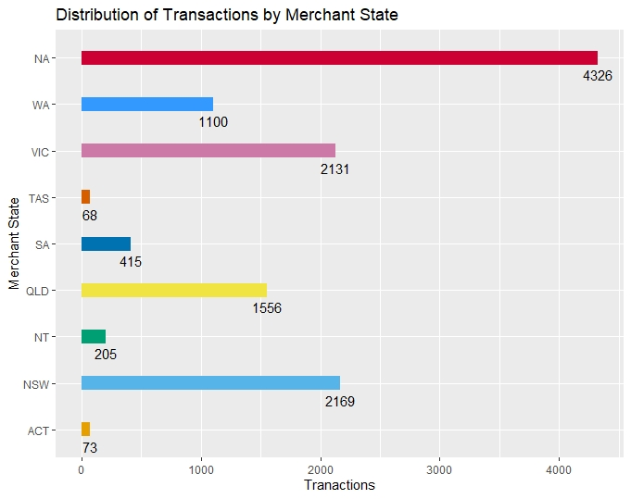
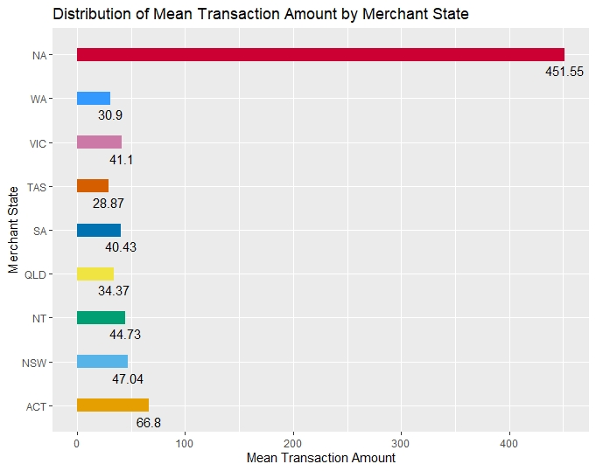
Analysis of Transactions by Merchant State
Figure 23
Figure 24
It is clear from Figure 23, that the merchant state is missing in nearly one third of the transactions. Though a higher number of transactions are recorded in the merchant states of Victoria and New South Wales, Australian Capital Territory records the highest mean transaction amount if the missing merchant state values were excluded. But however these decisions might not be reliable due to the presence of missing values.

Slide 20
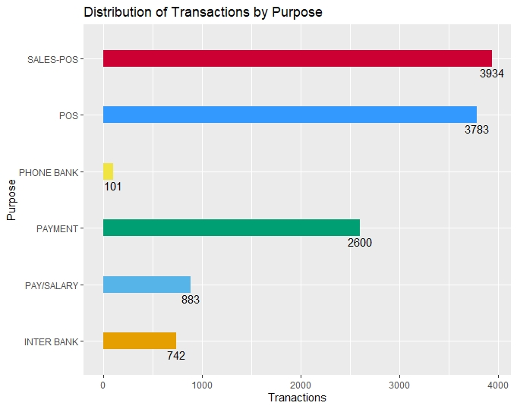
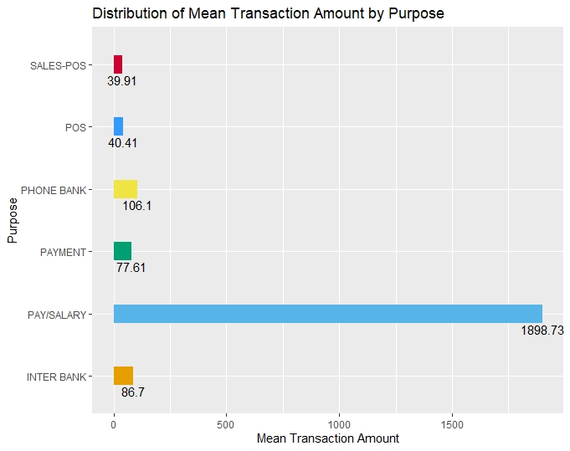
Analysis of Transactions by Purpose
Figure 25
Figure 26
Figure 25 illustrates the distribution of transactions by purpose. Majority of the transactions were Sales-POS and Point of Sales where a minority of the transactions are done behalf of phone banking. In contrast to that, it can be noticed from Figure 26 that the highest mean transaction amount is recorded from Payment/Salary where as the lowest from Sales-POS.

Slide 21

Synopsis of Exploratory Data Analysis
The male customer percentage is 56% and is higher than the female customer percentage.
The male customer percentage is comparatively higher than females in all the age groups except the ‘45-59’ age group.
Majority of the customers belongs to ‘18-29’ and ‘30-44’ age groups and it accounts 91% of customers.
Majority of the transactions are ‘Debit’ transactions which is of 93% and the mean transaction amount is positively skewed suggesting that customers are more likely to engage in mean transaction amount around $200.
The gender-wise distributions of the mean transaction amounts of males and females are also positively skewed suggesting that majority of the customers engage in mean transaction amount around $200.
The average number of transactions made by customers in each month is approximately 4014.
The customers aged ‘45-59’ records the highest median mean transaction amount suggesting that they tend to engage in a high mean transaction amounts than the youth(‘18-29’) and middle aged(‘30-44’) age groups.
The daily transaction count time series and the time series of daily mean transaction amount show strong seasonal behaviour within each week with no apparent trend.
Majority of the transactions are made by ANZ customers residing in Victoria, New South Wales and Queensland.
Majority of the transactions and that involve higher mean amounts are made by ANZ customers residing in major cities of Melbourne, Sydney, Brisbane, Adelaide and Perth.
Majority of the transactions are Sales-POS and POS while the highest mean transaction amount is recorded from Pay/Salary.

